Slide 1
Frühjahrstreffen 2022 Formal Modeling and Verification of Low-Level OS Code using Abstract Interpretation

Slide 2
Research Motivation
Formal Modeling and Verification of Low-Level OS Code using Abstract Interpretation
Vignesh Manjunath
Conventional
Challenges
Proposed Solution
Code
Formal models of BSW
Manual Porting
[Low-Level Code]
Configuration
Compositional Verification
[Correctness]
Total
Re-Validation
Validation
Code Generation
[Improved Portability]
Formal Modelling & Verification of Operating System Kernels for Portability & Correctness
PoC Use-Case: Context Switching use-case of Classic AUTOSAR OS for TriCore Architecture
Note: Code generation conceptualisation is a work in progress, it will be out-of-scope for this discussion
Notes:
Focus on Formal Modeling & Verification
Continuing Renata’s Work

Slide 3
Methodology: UPPAAL + Abstract Interpretation (OTAWA)
Formal Modeling and Verification of Low-Level OS Code using Abstract Interpretation
Verification Result
+
UPPAAL Model
Formal Modelling Tool
(UPPAAL)
LTL, Timing Verification
(UPPAAL)
Code Generation (High-Level / Low-Level [1]
Instruction Sequence Model
Verification Result
HW Independent
Generated Low-Level Code [1]
Instr. Seq.
Low Level Validation & Model Generation
HW Dependent
Final validated code
WCET
XGraph
OS Specifications
ISA Information
HW Specifications (Incl. ISA)
[AutoIO]
OTAWA WCET Analysis Framework
Post Generation Code Validation
Flow Fact Information & CLP Invariants
Data Flow
Xgraph Plugin & OTAWA Analysis Script
Physical Flow (XML, OSX..)
Low-Level Validation Framework

Slide 4
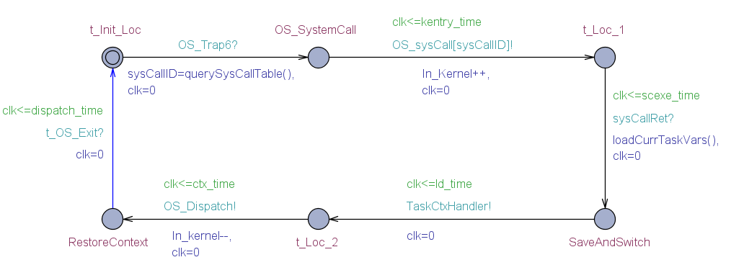
How the hardware independent OS specifications are using UPPAAL ?
Formal Modeling and Verification of Low-Level OS Code using Abstract Interpretation
UPPAAL Location
Location for verification purpose
Call to Instruction sequence model
UPPAAL Clock for Timing verification
Transition for verification purpose
UPPAAL Edge (Transition)
Fig: Abstract model of generic OS Context Switch flow using UPPAAL
Verification of Abstract Model
Liveness
Process.OS_SystemCall → Process.t_Init_Loc
Safety
A[] not deadlock
Reachability
E<> Process.RestoreContext
Note: The above set of verification formulas will be extended when the low-level models are integrated
Reference: [6]

Slide 5
How the micro-architectural analysis is performed with OTAWA?
Formal Modeling and Verification of Low-Level OS Code using Abstract Interpretation
WCET Script
Low-level OS Code
(.elf)
HW / ISA Info.
(XML, SimNML)
Program Analysis (CFG)
Control Flow Graph (CFG), Loop Bound Analysis, etc.
Flow Fact Info
Timing Analysis: Cache, Branch Pred, Pipeline, etc.
Results per Basic Block (BB) per Context: Abstract CPU State (Constant / Range of Values)
Timing Analysis
CLP Invariants
Implicit Path Enumeration Technique
- Objective Function
- Constraints
- Solver (Integer Linear Programming)
WCET Computation Formula
Max T= ∑ E_{i} . C_{i}
E- Execution Time of Basic Block
C – Execution Count of Basic Block
WCET Computation
Input Info.
Xgraphs
(Time information for every Instr.)
WCET Information
Output Info.
Reference: [3]

Slide 6
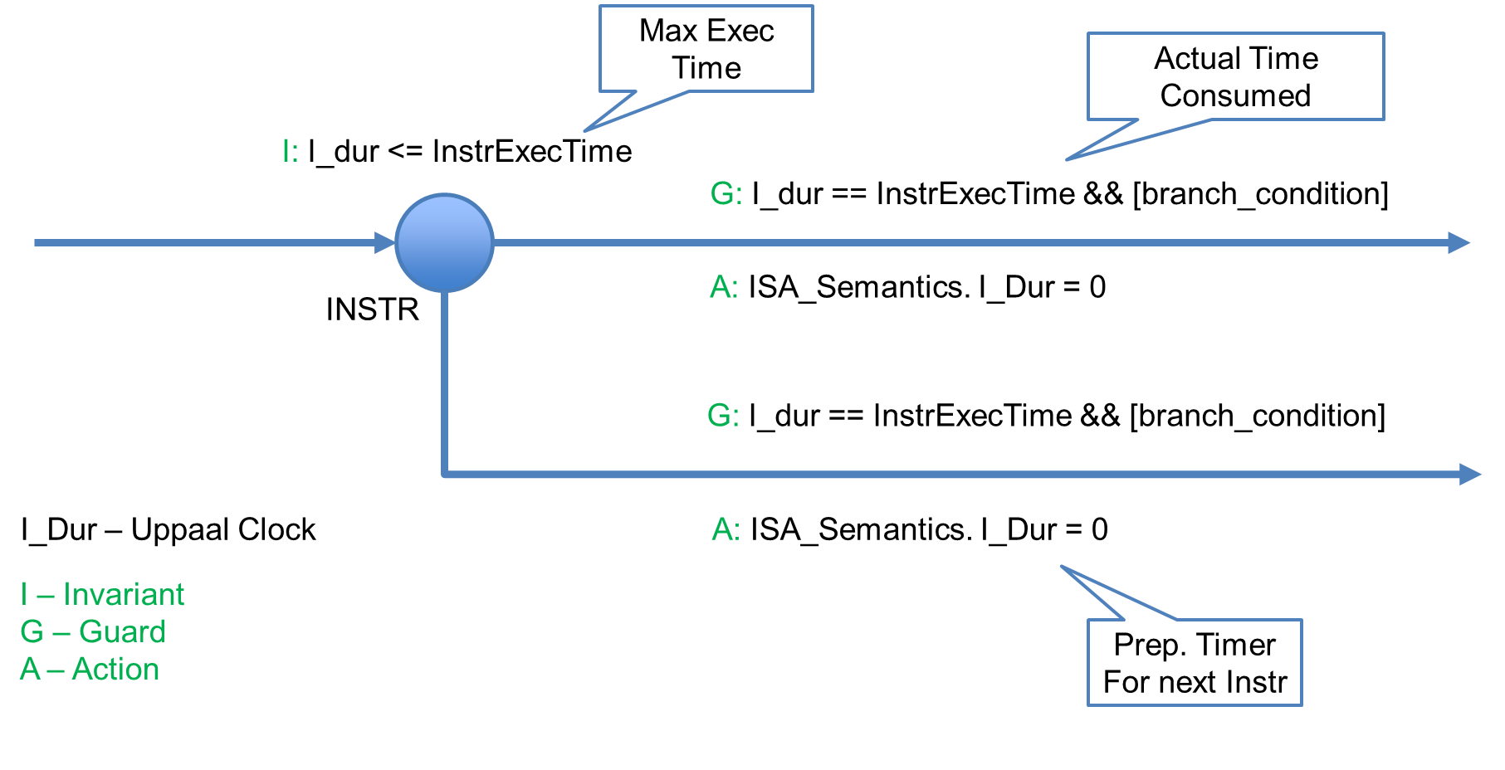
Execution Graph (XGraph) → Instruction Sequence Modeling in UPPAAL
How the micro-architectural analysis is performed with OTAWA?
G_{B} = (V_{B}, DR_{B})
V_{B} – stage(Instr. ID)
DR_{B} – Dependencies
Dependencies: (Solid →)
Data Dependencies
WB(I1) → EX(I3)
Pipeline stage
IF(I1) → ID(I1)
Degree of Superscalar
Buffer/Queue Size
Contentions: (Dashed ---)
Functional Unit
EX(I1) → EX(I4)
Memory Bus
Parallelism:
Parallel stage (Superscalar)
XGraph Info.:
Timing Info.
Instr. Sequence
Prologue BB
Note:
Prologue basic blocks (BB) are accounted
Target memory access events are annotated as dynamic cases per BB
Timing Information annotated with every node in XGraph
UPPAAL design pattern
for Instruction Sequence modeling
Reference: [3]
Notes:
Note:
The timing information (Arrival Time of a Node, Stage Duration) will be used for modelling
Arrival Time of a node = Max (Arrival Time of Prev. Node + Stage Duration)
The Prologue of every basic block defines the context and the set of events / case represents the possible “dynamic” memory access

Slide 7
Preliminary Results
Formal Modeling and Verification of Low-Level OS Code using Abstract Interpretation
Notes:
CFG
Execution Graph of Save Context
Low-level models

Slide 8
Factors influencing micro-architectural analysis
Formal Modeling and Verification of Low-Level OS Code using Abstract Interpretation
Sequence of WCET analysis
Flow fact information (Loop bounds, multi-branching..)
Correctness of the CFG
ISA and HW architecture specifications
Correct memory access annotations
Further Works…
Validation of XGraph results and model generation
Compositional verification framework for OS models
Code generation concept for UPPAAL models | Reference [1] [7] [8]
Proof of concept for classic AUTOSAR OS / SmartOS context switch in RISC-V architecture
OTAWA log analysis for reinforced validation

Slide 9
References
Formal Modeling and Verification of Low-Level OS Code using Abstract Interpretation
Renata et al., Code generation from formal models for automatic rtos portability
Clement et al., OTAWA: an Open Toolbox for Adaptive WCET Analysis.
Wei et al., Build your own static analyzer.
Thomas., A WCET Analysis Method for Pipelined Microprocessors with Cache Memories.
Hugues et al., Accurate analysis of memory latencies for WCET estimation.
Alexander et al., UPPAAL SMC tutorial.
Victor., Hard real-time Microcontroller code generation from timed automaton specifications.
Jesper et al., Automatic Translation from UPPAAL to C

Slide 10
Thank You!!!
Fair Use Policy and Legal Disclaimer:
This Presentation may contain copyrighted material the use of which has not always been specifically authorized by the copyright owner. In accordance with the copyright law, this material is distributed without profit to those who have expressed a prior general interest in receiving similar information for research and educational purposes. If you wish to use copyrighted material for purposes of your own that go beyond 'fair use', you must obtain permission from the copyright owner.

Slide 11
Discussion
Fair Use Policy and Legal Disclaimer:
This Presentation may contain copyrighted material the use of which has not always been specifically authorized by the copyright owner. In accordance with the copyright law, this material is distributed without profit to those who have expressed a prior general interest in receiving similar information for research and educational purposes. If you wish to use copyrighted material for purposes of your own that go beyond 'fair use', you must obtain permission from the copyright owner.

Slide 12
WCET Analysis?
Appendix
Program
CFG / AST Extraction
Path Analysis (Loop bounds)
Cache / Memory Analysis
WCET Computation ILP Formula
Max T= ∑ E_{i} . C_{i}
E- Execution Time of Basic Block
C – Execution Count of Basic Block
WCET Computation
Low-Level Analysis
Branch Prediction Analysis
Implicit Path Enumeration Technique
- ILP Objective Function
- ILP Constraints
- ILP Solver
IPET Based
ETS Based
Pipeline Analysis
Extended Timing Schema
- Worst Case Timing Abstraction
- Every path in program construct
- Scale to entire program
Generic WCET Computation flow
Notes:
CFG / AST Extraction based on IPET / ETS Analysis Schemes

Slide 13
IPET Analysis?
Appendix
Reference: [6]
Note:
The Timing analysis of every basic block is performed for every context Path and for every case
The case here refers to the set of “dynamic” memory access events possible for an instruction
Overview of the IPET method to estimate Worst-Case Execution Times

Slide 14
Abstract Interpretation based on CLP (simplified)
Appendix
Description:
Abstract State – Set of abstract (CLP) values for Registers and Memory
Constant Value
CLP Value (Bottom, Top, and CLP Range)
Based on Dominance Relationship
Update() – Single Path Entry
Join() & Update() – Multiple Path Entry
Basic Block
Update()
Expand
Assign
Contract..
Abstract
STATE_IN
Abstract STATE_OUT
Case 1: Single Path Entry to Basic Block
Abstract
STATE_IN
Basic Block
Update()
Expand
Assign
Contract..
Join()
Abstract STATE_OUT
Abstract
STATE_IN
Case 2: Multiple Path Entry to Basic Block (Loop Header..)
Notes:
CLP Invariants and flow facts

Slide 15
OTAWA Framework
Appendix
Architecture Abstraction Layer [2]
op mov reg ( c : reg d , b : r eg d )
image = format(”%4b %8b XXXX %4b XXXX %8b ”, c.image , 0x1F , b.image , 0x0B )
syntax = format (”mov %s , %s ” , c.syntax , b.syntax)
kind = 0 x10000000
action = { c = b ; }
ISA Support
Based on ADL – Sim-nML
Used by GLISS Framework
Instruction Decoding
Disassembling
Generate Functional ISS
HW Description (XML)
Processor – Pipeline, Functional Units,…
Caches – Capacity, Associativity,…
Memory – Memory Type, Access Latencies,…
Sim-nML Description of mov instruction
<cache-config>
<icache> <!--8KB-->
<blockbits>5</blockbits> <!--32Bline-->
<waybits>1</waybits> <!--2ways-->
<rowbits>7</rowbits> <!--128sets-->
</icache><dcache>...</dcache>
</cache-config>
Description of Cache (XML)
Reference: [2]
Notes:
ADL – Architectural Description Language
SimNML
GLISS - Generator of Instruction Set Simulator
NML Description:
-Operands
Bit level structure – also used for decoding
Syntax – syntax in assembly code
Kind – Instruction Characteristics - to which functional unit / to which pipeline it belongs, instruction class
Action – Instruction Behavior

Slide 16
How the micro-architectural analysis is performed with OTAWA?
Appendix
CLP Invariants
Flow Fact Info
HW / ISA Info.
(XML, SimNML)
OSX Script




Program Binary
FlowFact Module
CFG
Dominance Module
DCache Analysis
CLP Analysis
ContextValueInfo Module
ICache
Analysis Module


Prefetch / Branch Pred. Analysis
XGraph / BBTime Analysis
ILP Builder
(Optimization Problem)
WCET Computation (ILP Solver)



- HW architecture specific analyser
XGraphs
WCET Information

Slide 17
OTAWA Framework
Appendix
OTAWA WCET – IPET based Analysis Flow [3]
File Link

Slide 18
Modifications to the OS development cycle:
Appendix
OS Specifications
Changes when porting OS to a new HW
Assembly code implementation (manual)
Low-level validation framework:
Changes to ISA Spec.
XGraph code proc.
Flowfacts / CLP Invar.
LTL / TCTL formulas
C Code
[HW Independent]
Assembly Code
[HW Dependent]
Formal Models in UPPAAL
Low-level validation framework
Verification
Code Generation

Slide 19
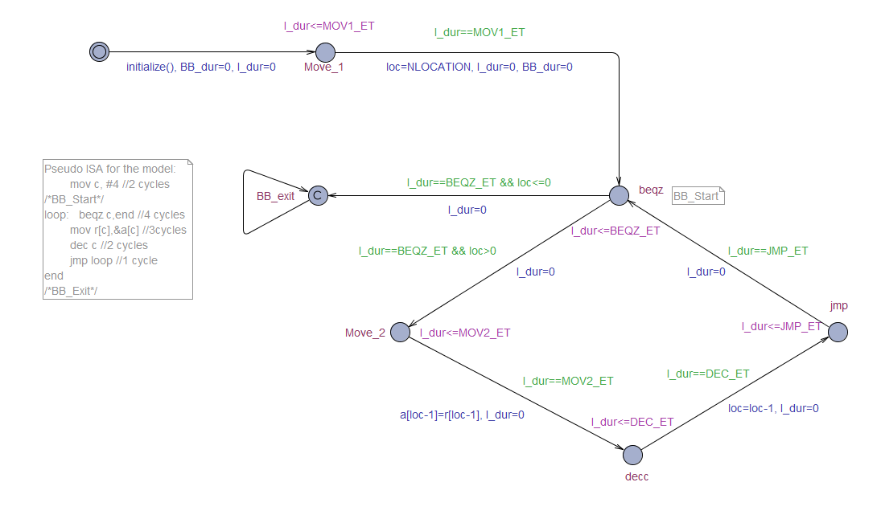
How the results of OTAWA analysis are used to model and verify the low-level specifics?
Appendix
Fig: UPPAAL model of pseudo ISA Sequence
Notes:
Lang Selection
Concepts for modelling
Formal modelling of OS Kernel
Concepts for verification
Map formal specification to low level code
Code generation satisfying FR and NFR

